Slide 1

SAVE FARMER (Mobile application)
Helps to alleviate sufferings of the farmers by clearing their long standing loans
Ganesh Athmagnanam (Software developer by profession, philanthropist by passion ;))

Slide 2
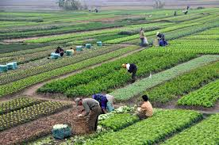
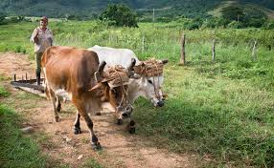
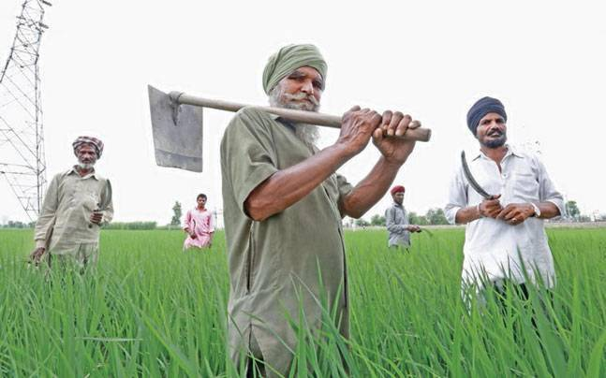
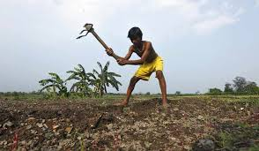
Farmers are real saviors of the world
Once in our life we need a doctor, a lawyer, a policeman and a preacher, but every day, three times a day, we need a farmer.
Farmers are best environmentalists around, because of their connection to the land, farmers do more to protect and preserve our environment than anyone else.

Slide 3

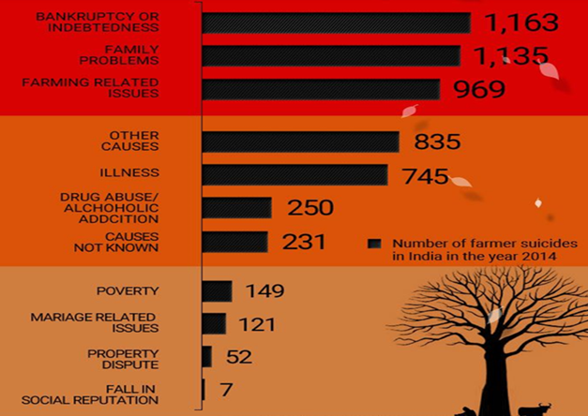
Loan from banks or private lenders.
Insufficient rains (untimely/scarce monsoon).
Not getting proper compensation for crop failure.
Not getting proper price for the farmed goods because of middlemen.

Slide 4
Purpose of ‘SAVE FARMER’
Save Farmer is a mobile based application (both in IOS and Android) developed to help farmers in clearing their long standing loans.
Using this application, general public can contribute to clear the loans of farmers. These donations can be made in partial loan amounts as well as by clearing the entire loan.
Save Farmer application holds information about multiple farmers and their loan details (Loan amount, Due date, Pending from date, etc.…) in a pre-defined sorted order. Above details has been gathered by Yaaligal team.
The list of farmers is displayed based on the priority to clear the debt. Various factors have been considered in sorting the available list.
To donate, anyone can download and install this application on their mobile phone, register them self, and can select the farmer they wish to donate to.

Slide 5
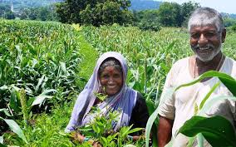
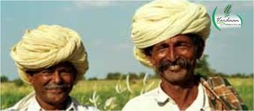
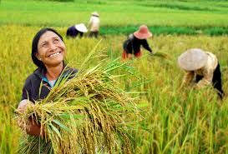
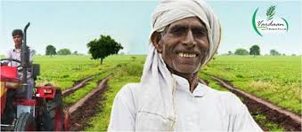
Purpose of ‘SAVE FARMER’
Donations made via ‘Save Farmer’ are eligible for tax exemption under 80G.
‘Save Farmer’ is a completely non-profitable app, working towards the upliftment of farmers.
Thank You!

